Slide 1
Presentation on
Simple Linear Regression
Prepared by
Syed Tauqeer Ahmed Hashmi

Slide 2
Simple Linear Regression
Often, two variables are related.
Examples:
The selling price of a home and its size.
Amount of advertising expenses and amount of sales.
Daily temperature and daily water consumption.
Undergraduate GPA and starting salary of graduates.
Weight of automobiles and miles per gallon.

Slide 3
Simple Linear Regression
When two variables are related, one can be used to predict the value of the other.
Examples:
Knowing the size of a home one can predict the selling price of a home.
Knowing the amount of advertising expenses, one can predict the amount of sales.
Knowing the daily temperature, one can predict the amount of water consumption.

Slide 4
Simple Linear Regression
Managerial decisions often are based on the
relationship between two or more variables.
Regression analysis can be used to develop an
equation showing how the variables are related.
The variable being predicted is called the dependent
variable and is denoted by y.
The variables being used to predict the value of the
dependent variable are called the independent
variables and are denoted by x.

Slide 5
Simple Linear Regression
Simple linear regression involves one independent
variable and one dependent variable.
The relationship between the two variables is
approximated by a straight line.
Regression analysis involving two or more
independent variables is called multiple regression.

Slide 6
Simple Linear Regression Model
The equation that describes how y is related to x and
an error term is called the regression model.
The simple linear regression model is:
y = β₀ + β₁x +ε
where:
β₀ and β₁ are called parameters of the model,
ε is a random variable called the error term.

Slide 7
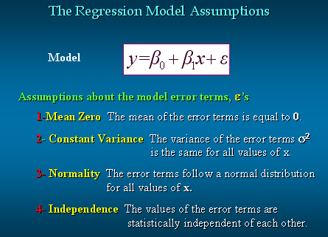

Slide 8
Simple Linear Regression Equation
The simple linear regression equation is:
E(y) = β₀ + β₁x
Graph of the regression equation is a straight line.
β₀ is the y intercept of the regression line.
β₁ is the slope of the regression line.
E(y) is the expected value of y for a given x value.

Slide 9
Simple Linear Regression Equation
Positive Linear Relationship
E(y)
Regression line
Intercept
β₀
Slope β₁
is positive
x

Slide 10
Simple Linear Regression Equation
Negative Linear Relationship
E(y)
Intercept
β₀
Regression line
Slope β₁
is negative
x

Slide 11
Simple Linear Regression Equation
No Relationship
E(y)
Regression line
Intercept
β₀
Slope β₁
is 0
x

Slide 12
Estimated Simple Linear Regression Equation
The estimated simple linear regression equation
The graph is called the estimated regression line.
b₀ is the y intercept of the line.
b₁ is the slope of the line.
is the estimated value of y for a given x value.

Slide 13
Estimation Process
Regression Model
y = β₀ + β₁x +ε
Regression Equation
E(y) = β₀ + β₁x
Unknown Parameters
β₀, β₁
Sample Data:
x y
x₁ y₁
. .
. .
x_{n} y_{n}
b₀ and b₁
provide estimates of
β₀ and β₁
Estimated
Regression Equation
Sample Statistics
b₀, b₁

Slide 14
Least Squares Method
Least Squares Criterion
where:
y_{i} = observed value of the dependent variable
for the ith observation
^
y_{i} = estimated value of the dependent variable
for the ith observation

Slide 15
Least Squares Method
Slope for the Estimated Regression Equation
where:
x_{i} = value of independent variable for ith
observation
y_{i} = value of dependent variable for ith
observation
_
x = mean value for independent variable
_
y = mean value for dependent variable

Slide 16
Least Squares Method
y-Intercept for the Estimated Regression Equation

Slide 17
Simple Linear Regression Example
A real estate agent wishes to examine the relationship between the selling price of a home and its size (measured in square feet)
A random sample of 10 houses is selected
Dependent variable (y) = house price in $1000.
Independent variable (x) = square feet

Slide 18
House Price in $1000s (y) | Square Feet (x)
245 | 1400
312 | 1600
279 | 1700
308 | 1875
199 | 1100
219 | 1550
405 | 2350
324 | 2450
319 | 1425
255 | 1700
Sample Data

Slide 19
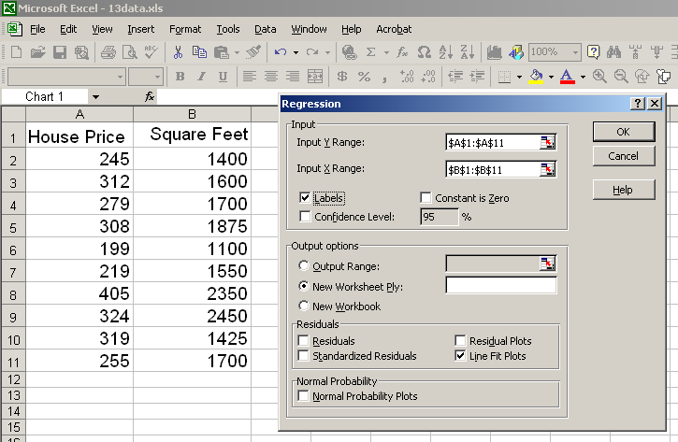

Slide 20
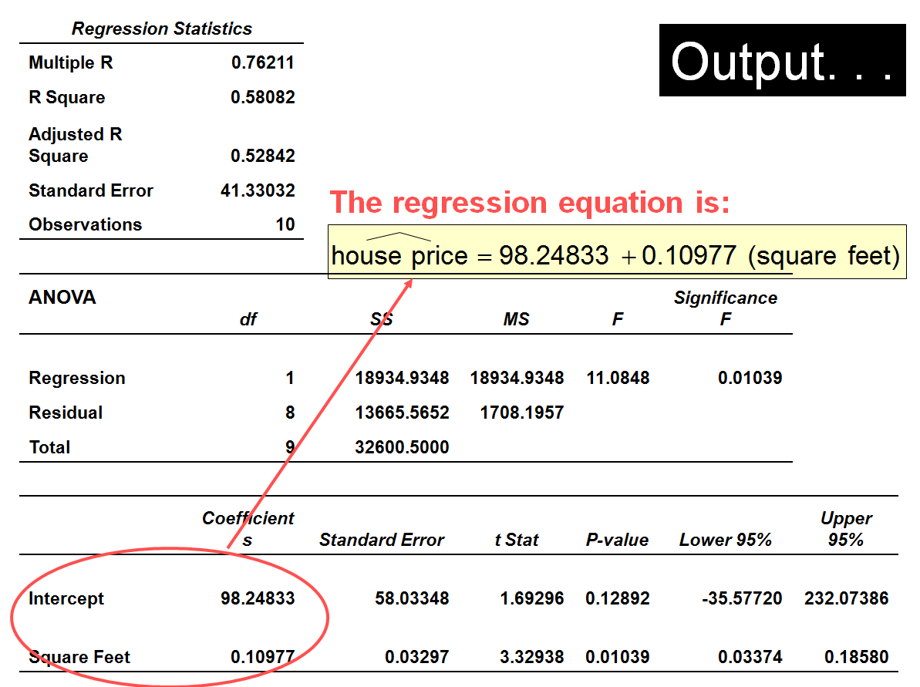

Slide 21
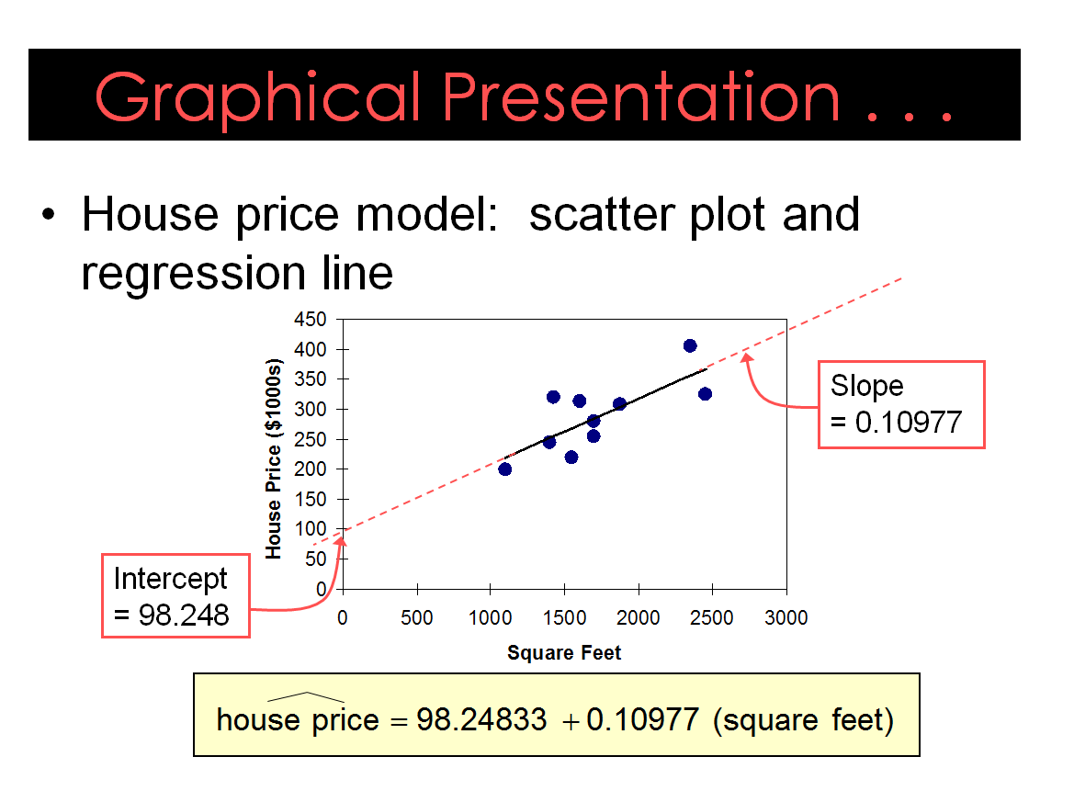

Slide 22
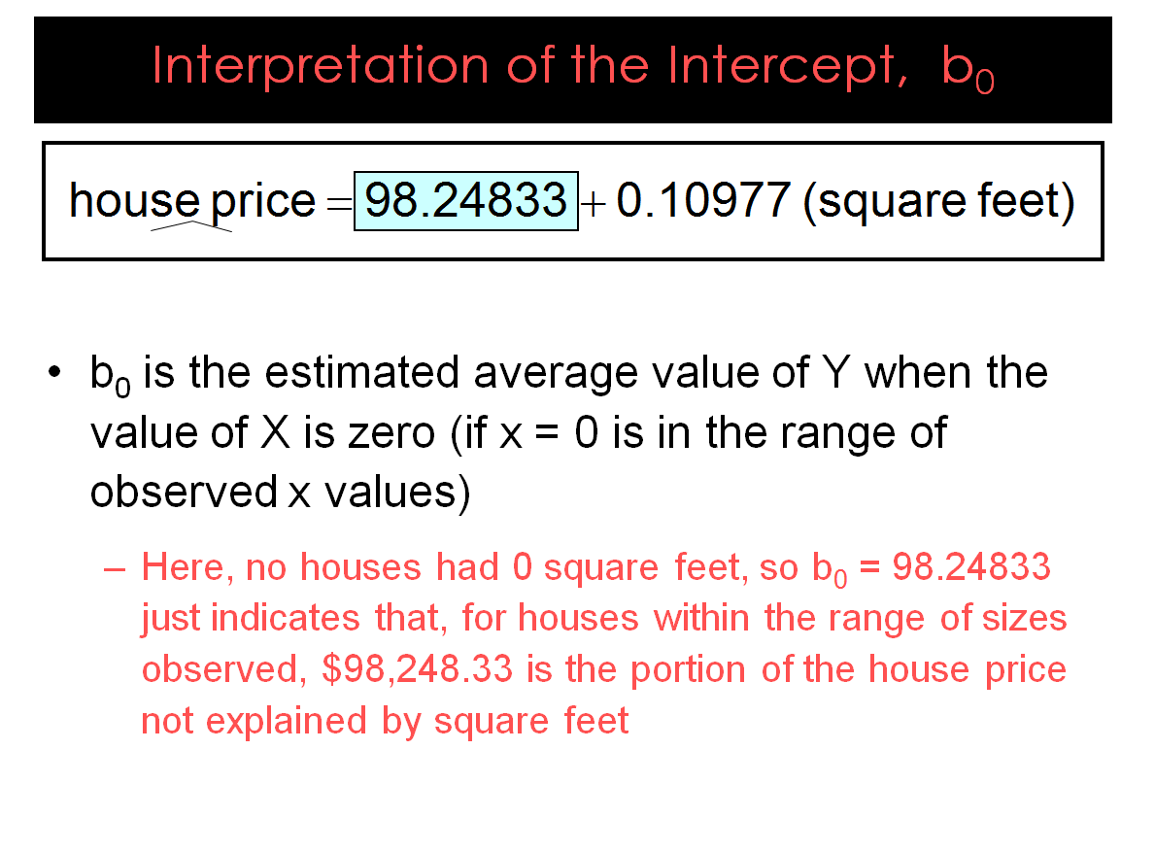

Slide 23
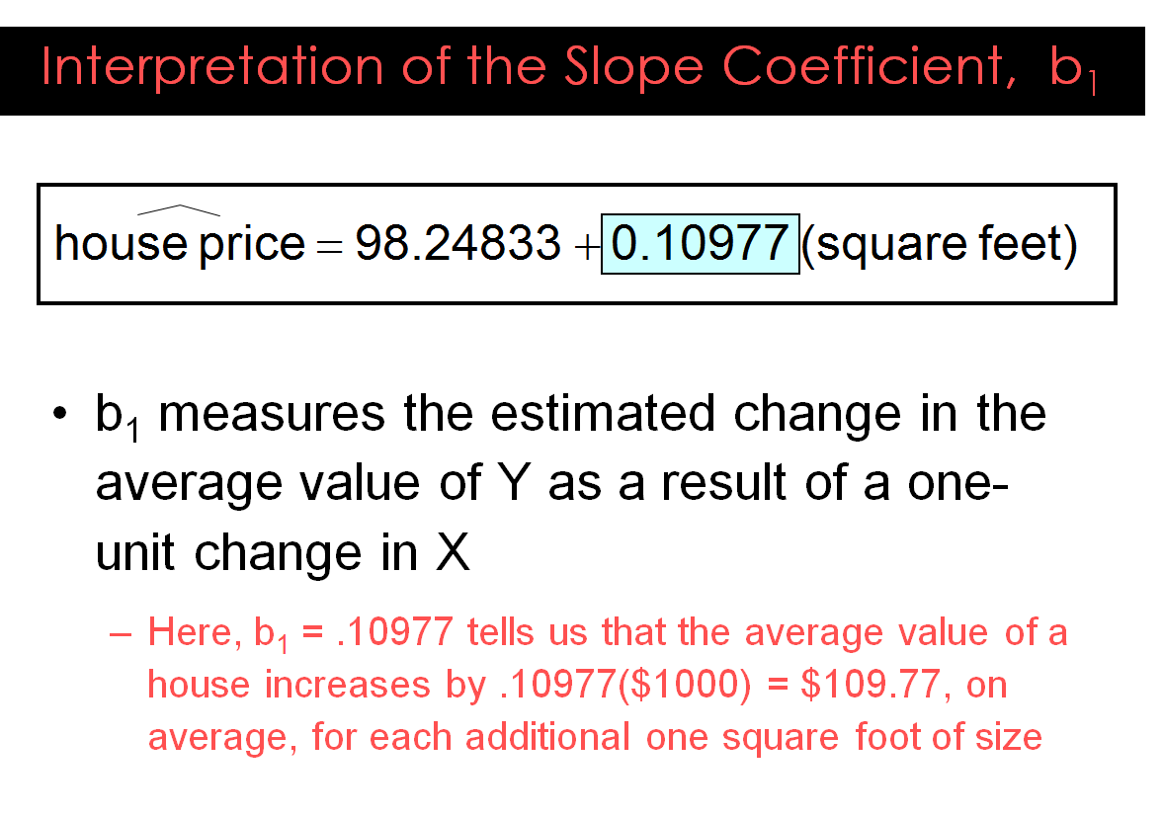

Slide 24
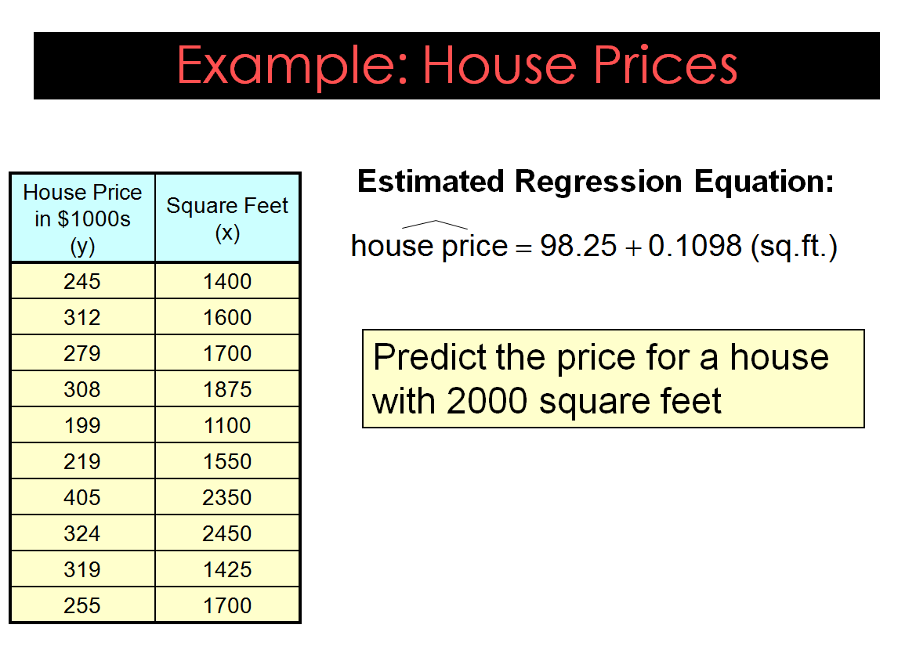

Slide 25
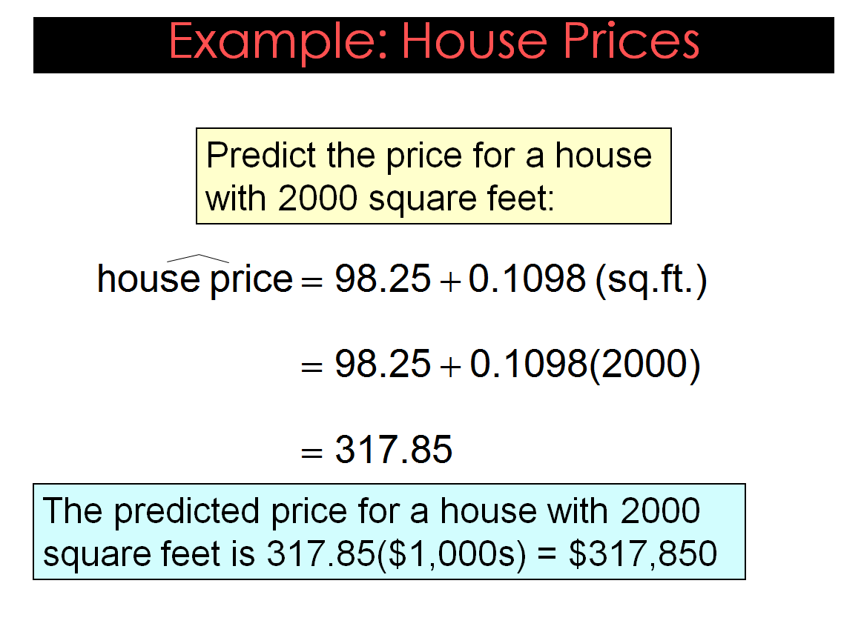

Slide 26
Coefficient of Determination
In regression analysis, the following natural question arises:
How well does the regression equation forecast the actual data?
This question is answered by a quantity that we call “Coefficient of Determination”

Slide 27
Coefficient of Determination
To understand the Coefficient of Determination, one has to understand the following three quantities:
SSE = Sum of Squares due to Error = ∑ (y – ŷ)²
SST = Sum of Squares Total = ∑ (y – y) ²
SSR = Sum of Squares due to Regression = ∑ (ŷ – y) ²

Slide 28
Coefficient of Determination
Relationship Among SST, SSR, SSE
SST = SSR + SSE
where:
SST = total sum of squares
SSR = sum of squares due to regression
SSE = sum of squares due to error

Slide 29
Coefficient of Determination
The coefficient of determination is:

Slide 30
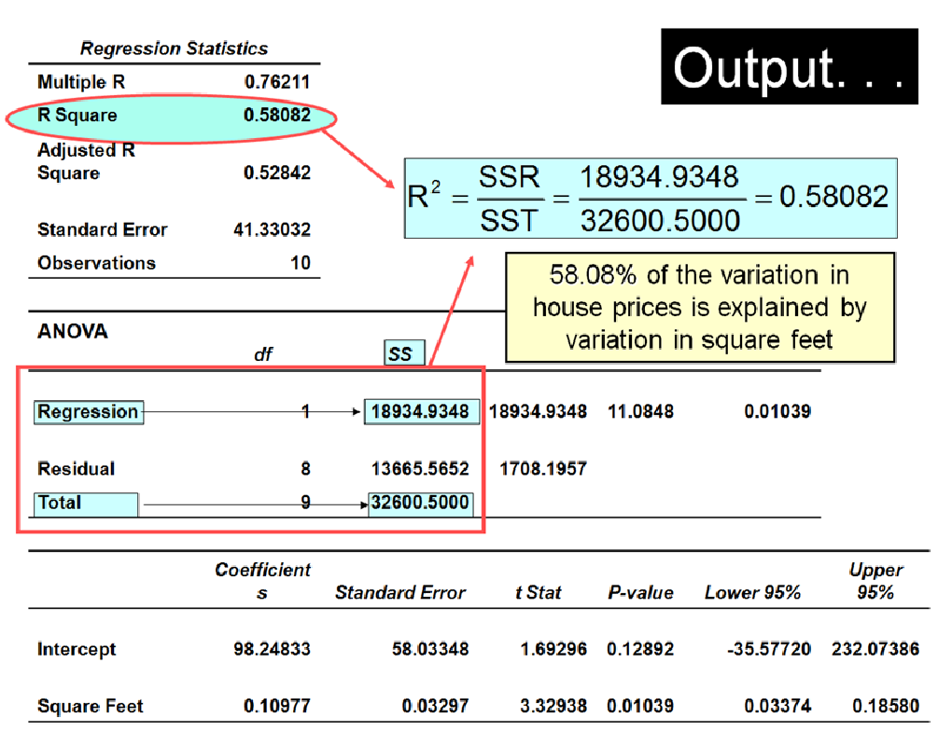

Slide 32
Thank You

